Slide 1
Multi-focus Dashboard Camera

Slide 2
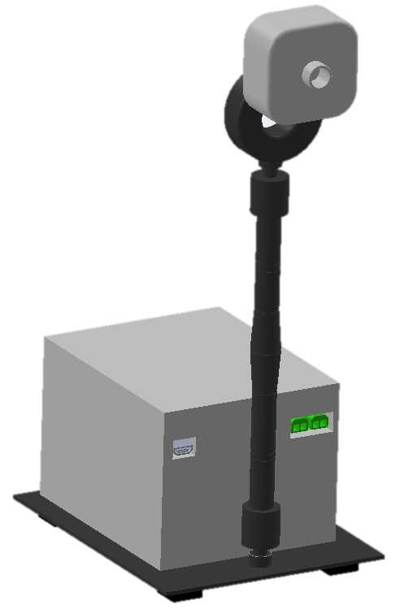
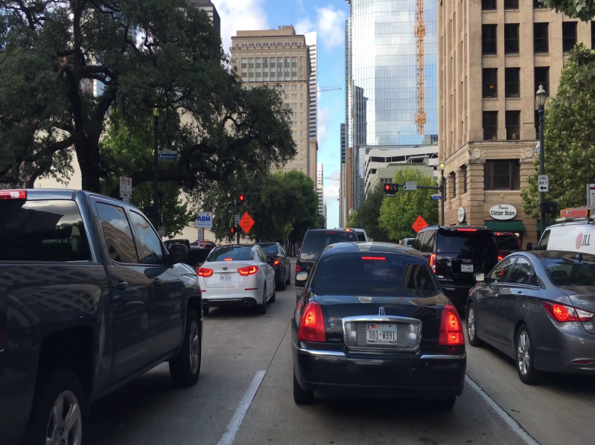
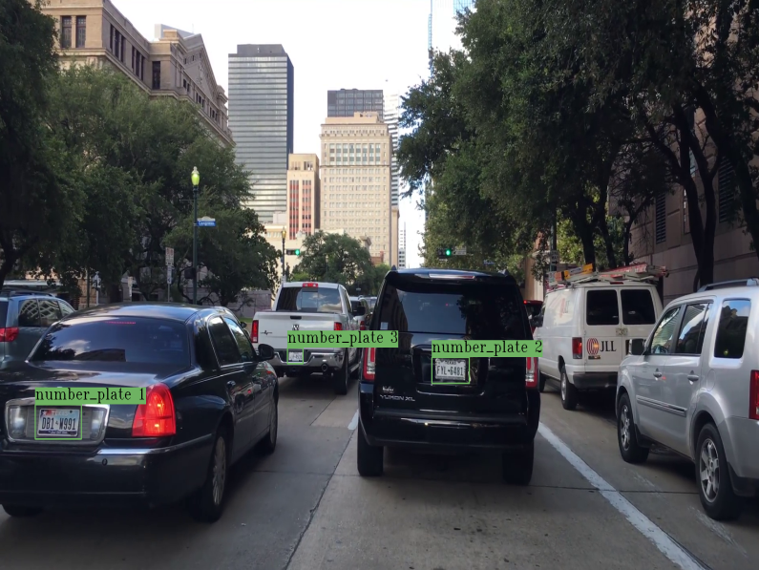
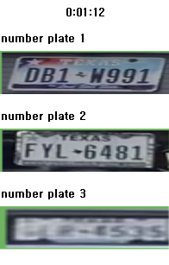
1. System Configuration
320 x 240
640 x 480
1280 x 960
Start
Stop
640 x 480
Setting
< Video Record >
Open File
Night
Vision
Plate
Recognition
< Multi-focus Dashboard Camera >
< Video Processing >

Slide 3





2. Development Environment
F/W Development
Video Record Program
Housing Design
Video Processing

Slide 4



3. System Functions
Near-focus video
Far focus video
Simultaneous provision of two focus images
Automatic recording when detecting an event (shock)
Night vision
License plate recognition

Slide 5

4. Explanation of Functions
1) Simultaneous provision of two focus images – Varifocal Lens
Soft motor
Lens
Sensor
Sensor
CCD
Near
Focus
Far
Focus
Near
Focus
Far
Focus
V+
Frame
Frame
< Electric Field O >
< Electric Field X >
When an electric field is applied, the flexible motor moves convexly toward the upper gold ground electrode due to electrostatic attraction
If an electric field is not applied, the flexible motor returns to its initial state due to its elastic restoring force

Slide 6
4. Explanation of Functions
1) Simultaneous provision of two focus images – Voltage Switching
5V
Voltage
5V
Voltage
100Ω
100Ω
①
IRED 1
Opto Diode 1
IRED 1
Opto Diode 1
Signal 1
①
Signal 1
GND
GND
5V
5V
100Ω
Opto Diode 2
Lens
100Ω
②
Lens
Opto Diode 2
IRED 2
②
IRED 2
Signal 2
Signal 2
GND
GND
GND
GND
< Charge >
< Discharge >
IRED : Element that emits infrared rays
Opto diode : An element that has the property of flowing current when exposed to infrared rays

Slide 7

4. Explanation of Functions
1) Simultaneous provision of two focus images – Frame Division
Frame 1
(Near focus)
Near focus
Video
Near focus
Video
Far focus
Video
Varifocal Lens
…
Camera
Distance
: Near object
Focus Control Module
Frames
< Video output >
Frame 2
(Far focus)
Far focus
Video
: Distant object
< Video Record >

Slide 8


4. Explanation of Functions
2) Automatic recording when detecting an event(shock)
Automatically records video from 10 seconds before to 10 seconds after the event is detected
Function
Near focus frames
Frame 1
(Near focus)
Oldest frame
Current frame
=
Event
!!!
Event Detection
Pop
Push
=
Old frames
Frame 2
(Far focus)
Buffer size equal to 10 seconds
Far focus frames
Maintain a buffer size of 10 seconds by repeating the process of pushing a new frame and popping the oldest frame.
When an impact occurs, continuously updated old frames are stored in video files corresponding to each focus.

Slide 9
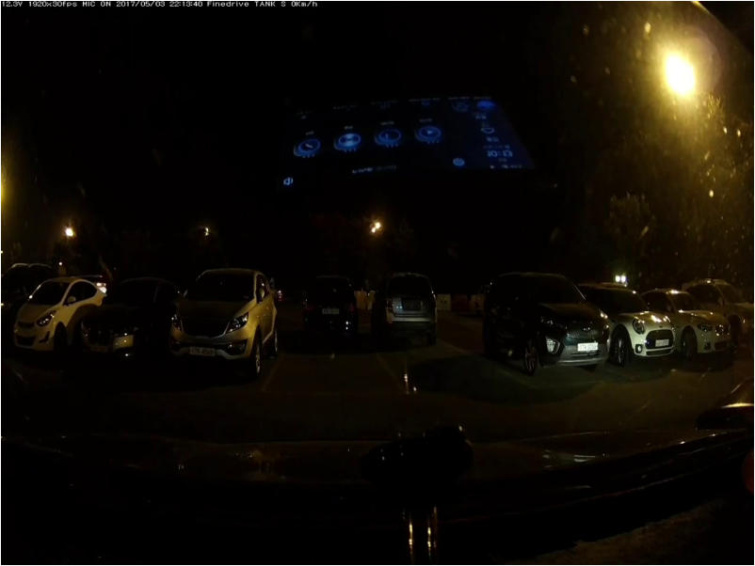
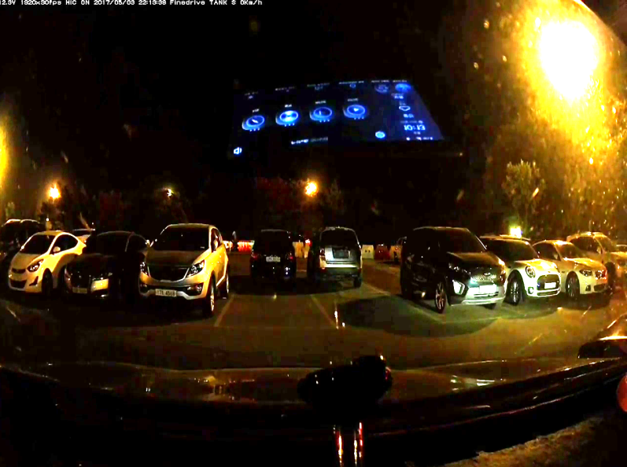

4. Explanation of Functions
3) Night vision
Brightens an overall dark image
Function
Overall dark video
Increased contrast for all pixels
Night vision function application video

Slide 10
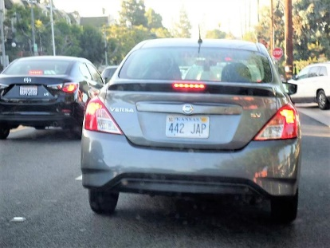

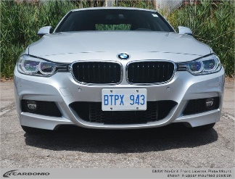
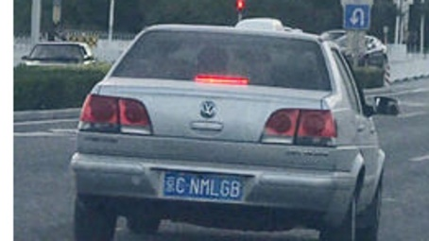
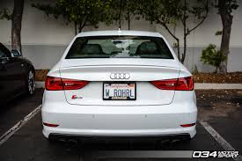
4. Explanation of Functions
4) License plate recognition
The license plate in the video is recognized, enlarged, and displayed.
Function
<number_plate>, <x>, <y>, <width>, <height>
Constructing a dataset of approximately 2,000 car license plate images
Label all images in the dataset
Create a text file containing the location information of the license plate for each image

Slide 11
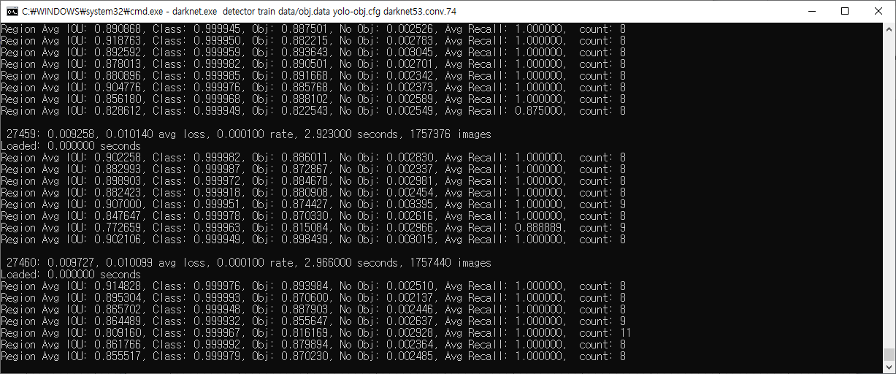

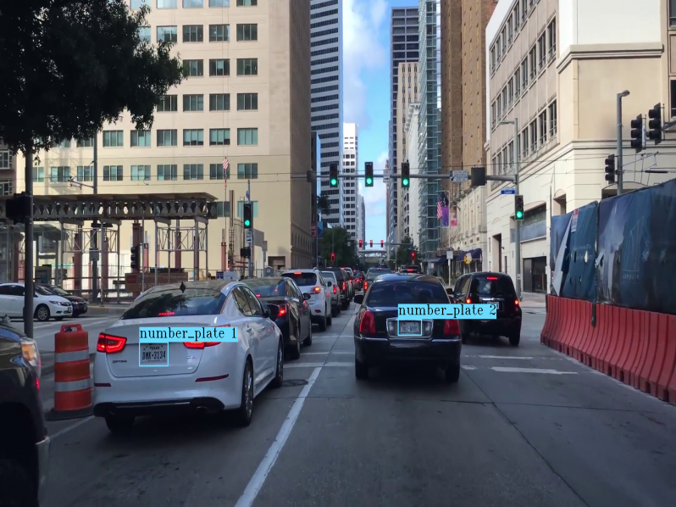
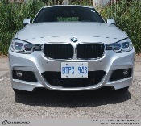
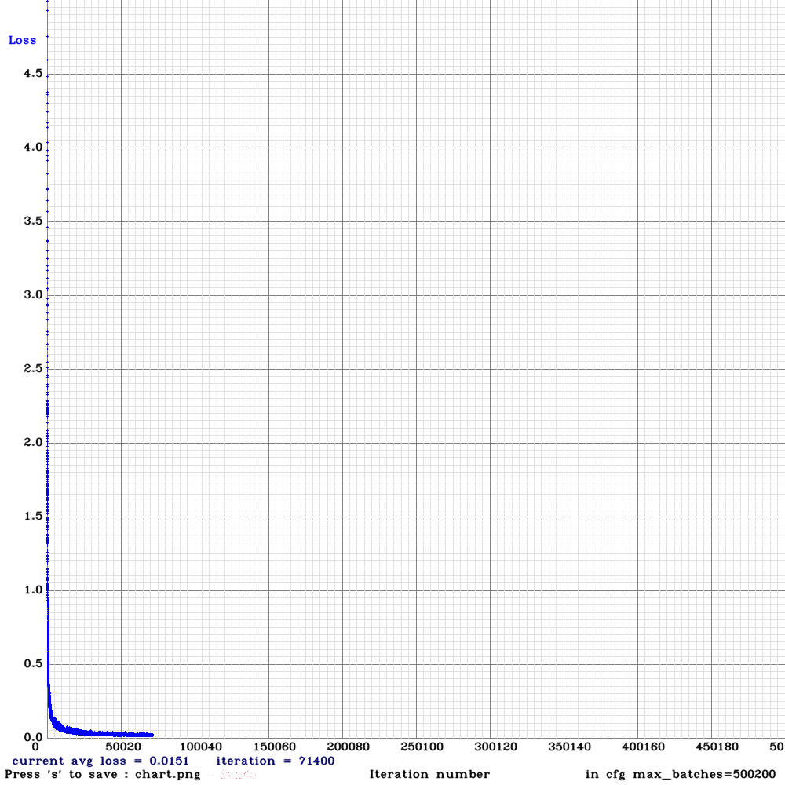

4. Explanation of Functions
4) License plate recognition
The license plate in the video is recognized, enlarged, and displayed.
Function
<number_plate>, <x>, <y>, <width>, <height>
Start deep learning using image datasets and text files
After deep learning is completed, a .weight file that recognizes license plates is created.
Recognize license plates in videos using .weight files

Slide 12
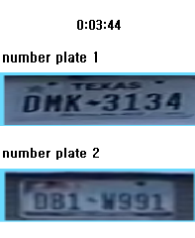
4. Explanation of Functions
4) License plate recognition
The license plate in the video is recognized, enlarged, and displayed.
Function
Extract recognized license plate images and display them on the screen

Slide 13
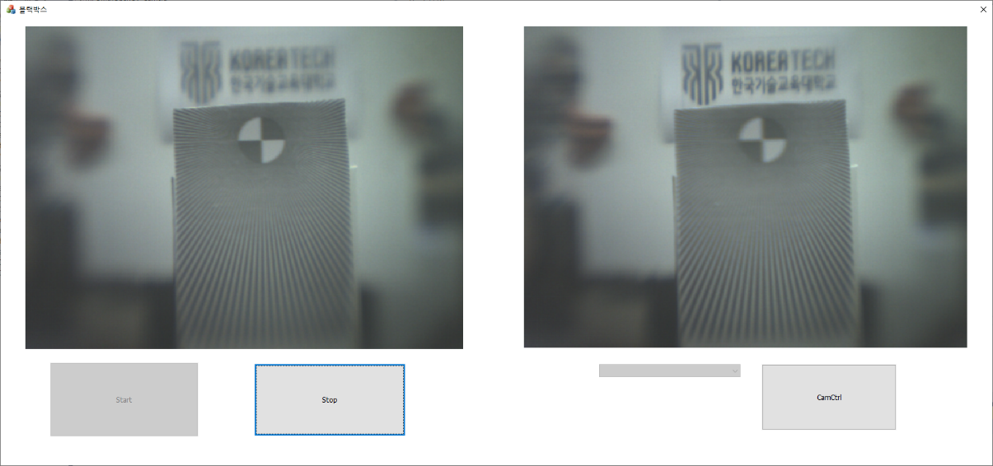
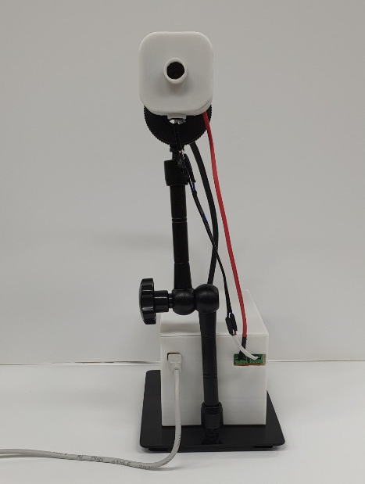
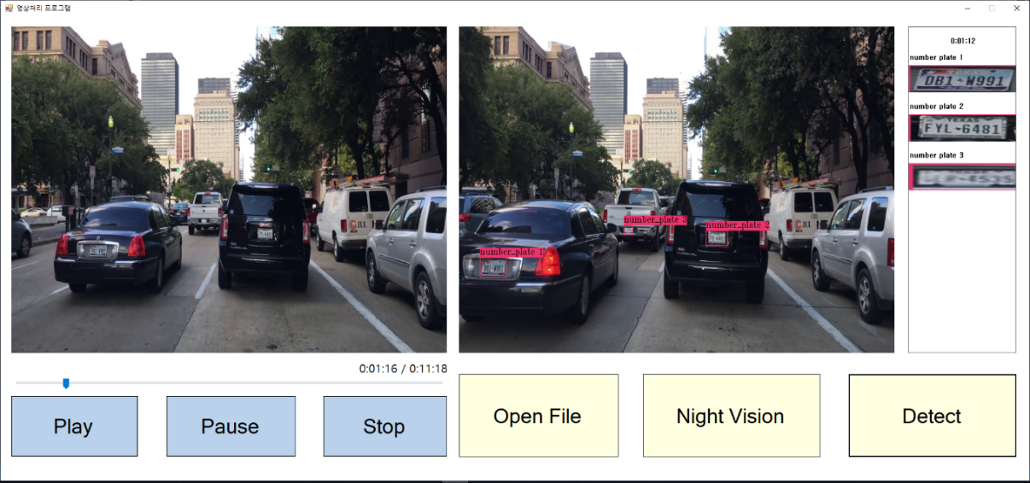
5. Implementation
< Video Record >
< Multi-focus Dashboard Camera >
< Video Processing >

